Slide 1
Evolving systems design from unreliable rpc to resilience with Linkerd
Edward Wilde

Slide 2
Notes:
Hi I’m Ed,
I’m a developer I work at form3

Slide 3
Notes:
At form3 we’ve done something really amazing. In the last 18 months we’ve built a new type of payments platform
Imagine you are a new challenger digital only bank like Monzo. You need to build features that enable your users to send payments in real time to other peoples account to any bank in the UK, maybe youre a fan of `EUROPE` and want to send real time payments within the Eurozone. You want to do international payments anywhere in the world

Slide 4
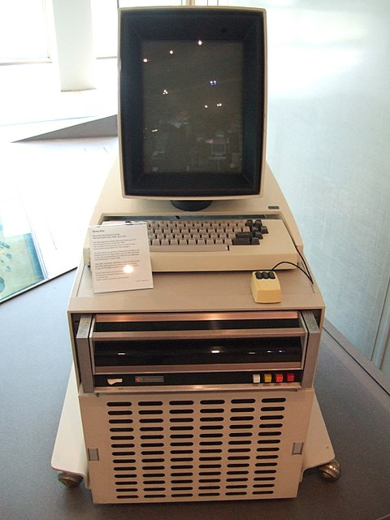


Notes:
I really love stories about software & hardware development:
Some personal favorites:
Dealers of lightening which charts the success of the Xerox parc research laboratory founded in 1970 to explore the office of the future. In 5 years invented:
Founded by George Pake & ran by Bob Taylor,
The laser printer
Object oriented programming with Smalltalk (Alan Kay)
Bitmap graphics
First GUI based personal computer (Butler Lampson $20K)
Ethernet (Bob Metcalf)
Show stopper!

Slide 5
A story about unreliable RPC
System 1
Increased reliability
Reduced overall latency
But….
Did not manage to reduce tail-latency
Did not manage to protect services
System 2
Increased reliability
Reduced overall latency
Protected services
But…
Still need to work more on tail-latency
Notes:
My brief story is how the same group of engineers worked on two different systems improving inter-service communication

Slide 6
Tail latency
Notes:
Imagine we sort the time it takes to complete a request from quickest to longest, that’s how you calculate percentiles for latency
In this graph we see that the 99 percentile is 0.3 that means 99% of requests were 0.3ms or quicker, or another way of looking at that is 1% of requests took longer that 1%.
At the 99.99 percentile we see requests are an whole order of magnitude greater than the 99% this is our tail latency.
In a system that has 1 million users 100 users will experience the worst part of that tail latency and 10,000 users will experience some part of the tail latency. And this is only for a system that has one request
If your system has 10 requests that make up part of the page view those figures start to look a whole lot worse quite quickly!

Slide 7
System 1
Notes:
The system allows customers to trade shares, foreign exchange and commodities
The system was api driven and made up of more than 200 services, with many instances of each service, spread across two datacenters in active / active arrangement
It worked well, however we sometimes got reports from customers that they would place a trade and nothing would happen

Slide 8
Notes:
It was a monolith, actually the worst kind of monolith – the distributed monolith!

Slide 9
System 1
Notes:
The request would be placed on a queue
Service-b would process the request and place the response on the `response queue`
Where it would get picked up by the api gateway and send back to the client
This worked ’okay’ for the majority of cases under normal load
However occasionally we would get reports from customers that they placed a trade and saw nothing happen

Slide 10
Timeout!
Notes:
What was happening is that the request would timeout waiting for a response
We noticed that using a message broker in an RPC call chain didn’t seem to perform well under load, it was also a centralized point of failure

Slide 11
Let’s try http
Notes:
We started with one service and replaced the service-to-service communication with straight forward http proxy
In our lab this performed much better than using the message broker
We were happy and congratulated ourselves on our brilliant idea!

Slide 12
Oops still timeout
Notes:
That was until we started seeing timeouts again

Slide 13
Try that again
Notes:
We noticed that the timeouts some times occurred when a service was garbage collecting, if only it had just gone to another instance!
So we wrote a little retry library, in most cases the next request would succeed without a problem

Slide 14
Busy day, more timeout
Notes:
However when the system was particularly busy we still saw the timeouts, and our retry code was making a bad situation worse!
As all the services were busy, retry was not a particularly sensible option

Slide 15
System 2: Service to service communication in a microservices architecture
Notes:
When we started form3 we were conscious of the problems we encountered on our last system with service-to-service communication
We looked at using an off-the-shelf libraries that would handle retry, back-off and circuit-breaker
Con
These libraries are language specific
Maintaining these libraries becomes difficult

Slide 16
Service mesh
Retry failures / timeout
Implements circuit breaker
Security
Routing logic & service discovery
Blue / green deployments: canary releases etc…
Distributed Tracing
Other services meshes are available: istio
Notes:
A service mesh is a dedicated piece of infrastructure to manage service to service communication

Slide 17
Tracing
Notes:
Linkerd seamlessly integrates with zipkin and publishes trace information
This is really helpful in allowing you to discover which services play a role in particular requests, as well as seeing where the time is being spent

Slide 18
Service mesh in a microservices architecture
Notes:
Here you can see why it’s called a mesh. Each node in our network has linkerd running on it and all communication goes through linkerd
This kind of a setup is known as a linker-to-linker configuration
Between host computers you call via services via the linkerd process
Why?
You might be thinking. Well, only allowing linkerd communication means that we only have to manage TLS for linkerd and we only allow linkerd ports to be exposed on our internal network which narrows our attack surface considerably
Client benefits (retry, timeout)
Metrics

Slide 19
Demo: system-1
Notes:
This first demonstration mimics the initial system 1 behavior before we started to improve it:
Quickly covers:
Load test tool
Influx and grafana
Nginx configuration
Go program
Docker compose

Slide 20
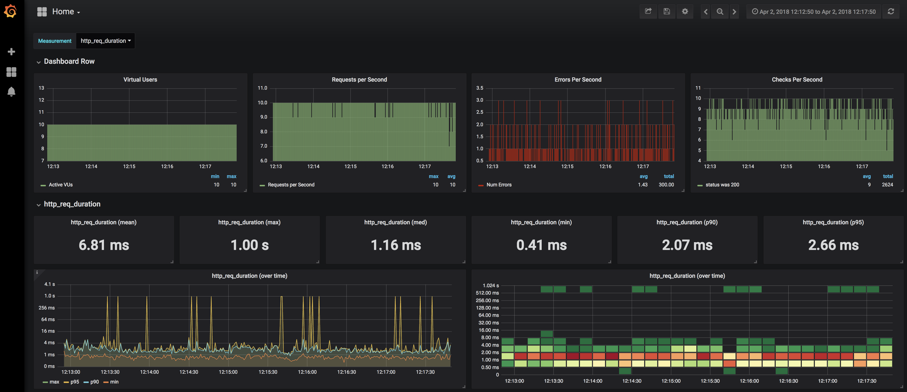
System 1: Response times
Notes:
As you can see we have a consistent number of request failures being sent back to the end user
Show those errors in docker logs

Slide 21
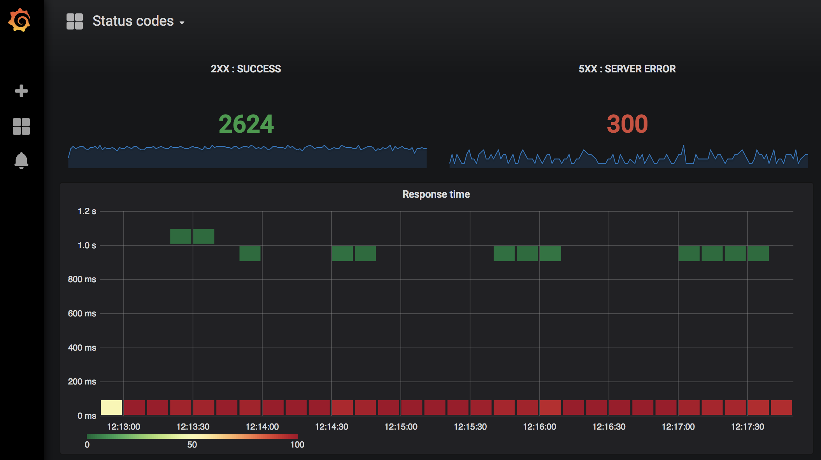
System 1: Response times
Notes:
And you can see the tail latencies on this heat map

Slide 22
Demo: system-2
Notes:
In the second demo we’ve just injected linkerd into our request flow and added consul to the mix – all of which was incredibly straight forward
Quickly show:
Fire up the demo,
Show change nginx config
Show linkerd configuration

Slide 23
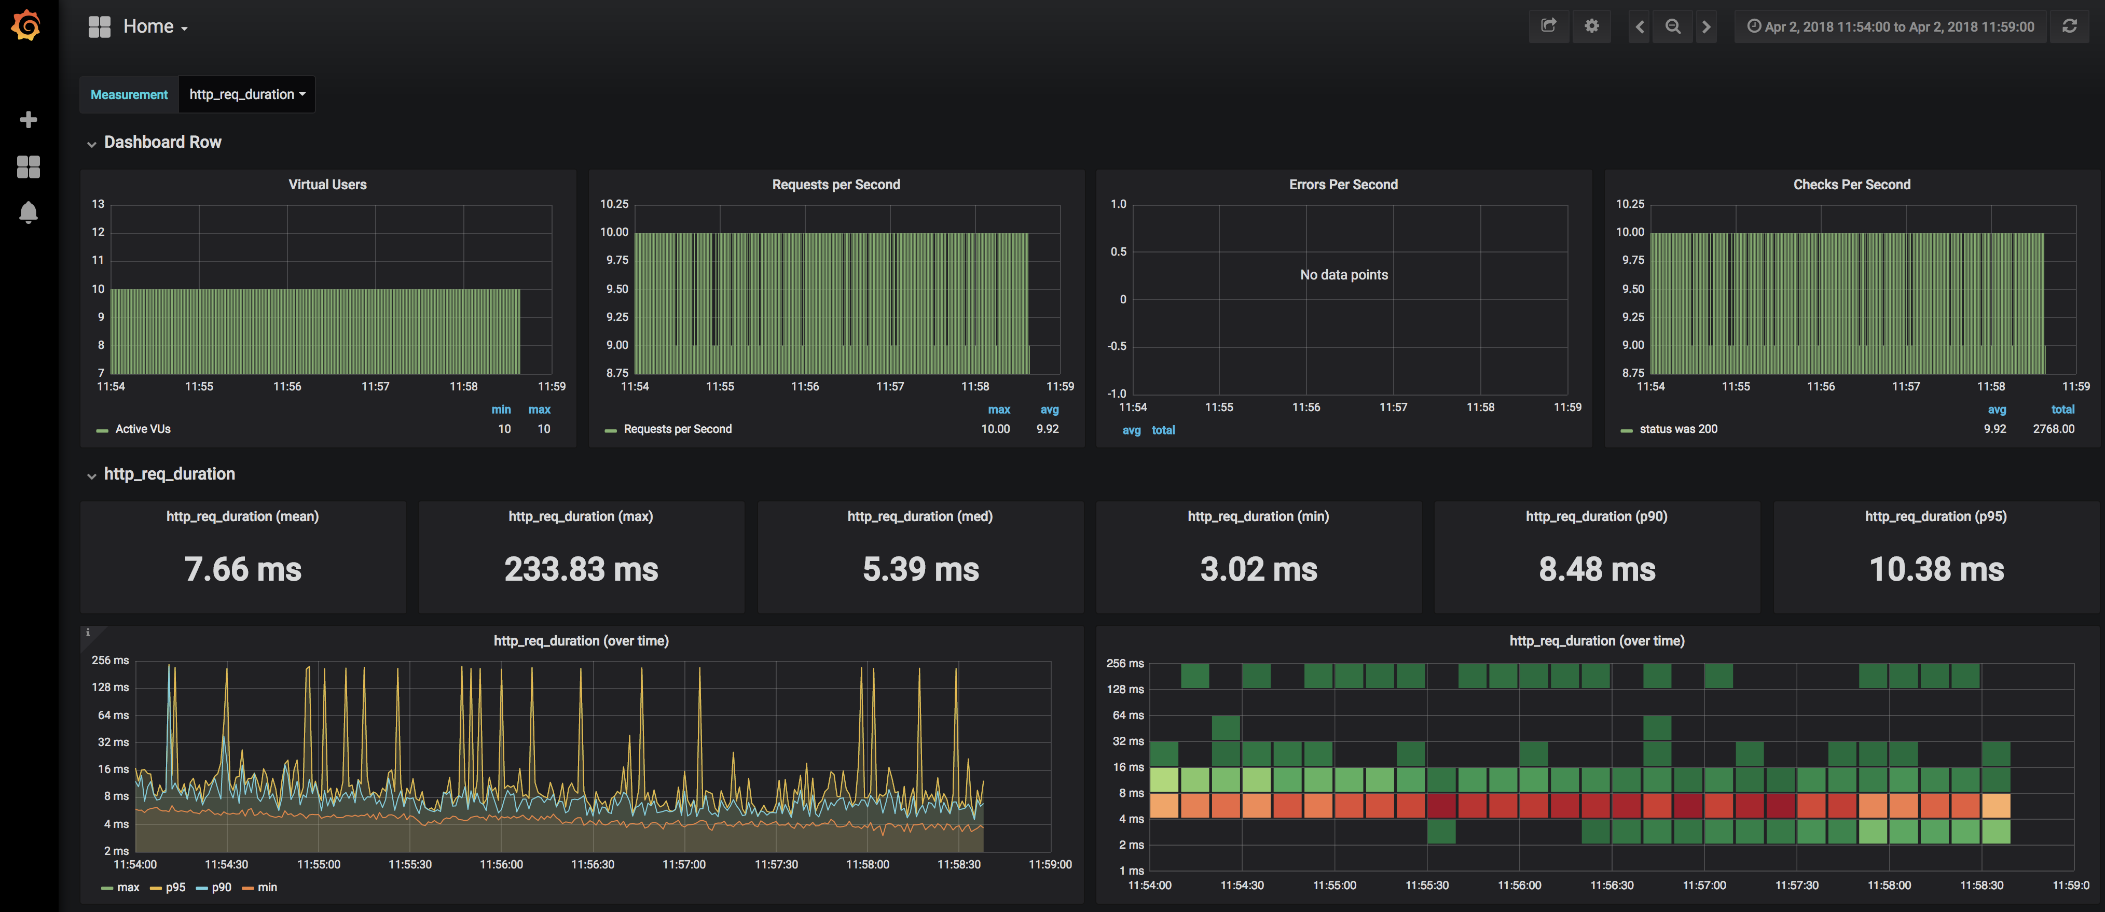
System 2: Response times
Notes:
Dramatically we can see that the errors have completely gone away, but they were still being generated by the services!
Also we’ve reduced the worst of the tail latency by 75% from 1second to 250ms

Slide 24
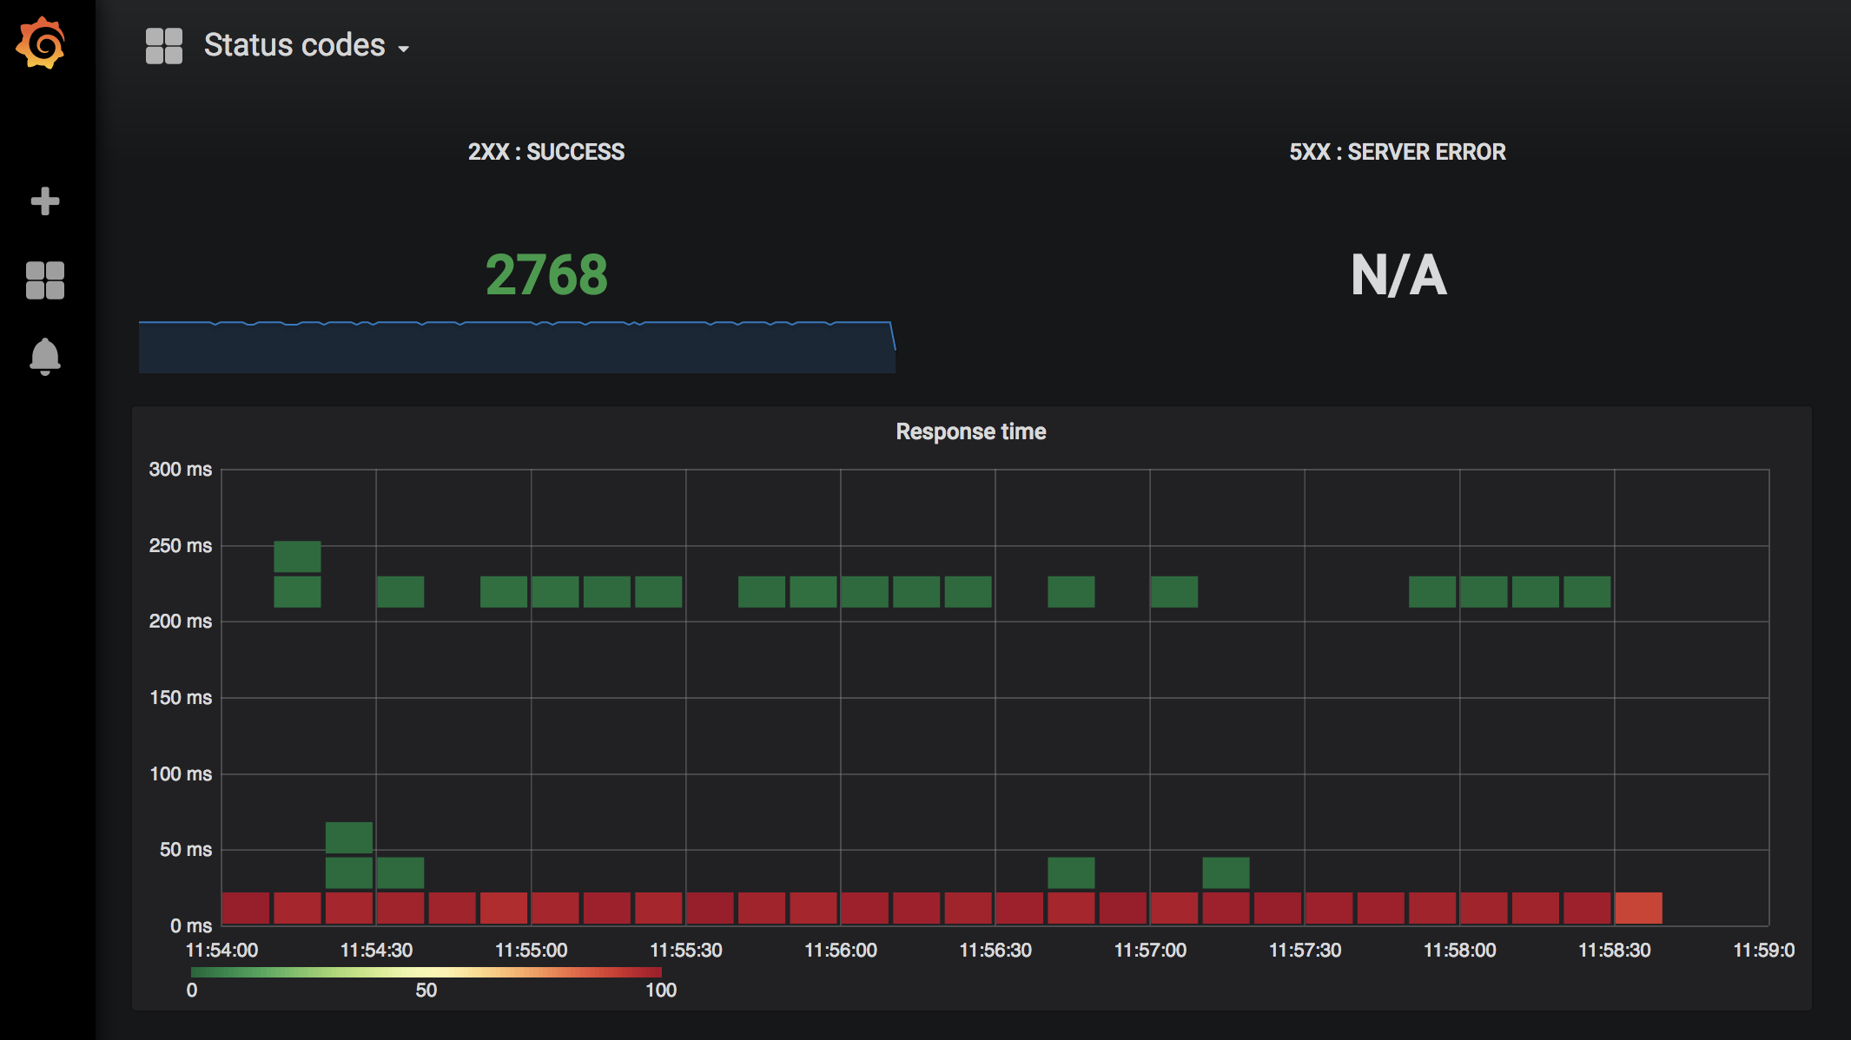
System 2: Response times

Slide 25
How do the 2 demos compare?
System 1
System 2

Slide 26
Further improving tail latency
Notes:
We have some more work to do to get tail latency to an acceptable level
Google published some interesting research in 2013, the original paper is available in full PDF from Pen State University and via subscription from the ACM.
Google is using a technique called ‘hedge requests’ If a request starts to take longer than the n-th percentile, you can choose to issue the same request again, and use the response of the request which replies first to send to the client.

Slide 27
Hedge requests

Slide 28
Hedge requests

Slide 29
Wrap it up
We have used Linkerd in this demo to
Reduce error rates using retries
Minimize tail latencies using timeouts
Additionally at Form3 we use it to:
Increase security &
Help diagnose problems using tracing

Slide 30

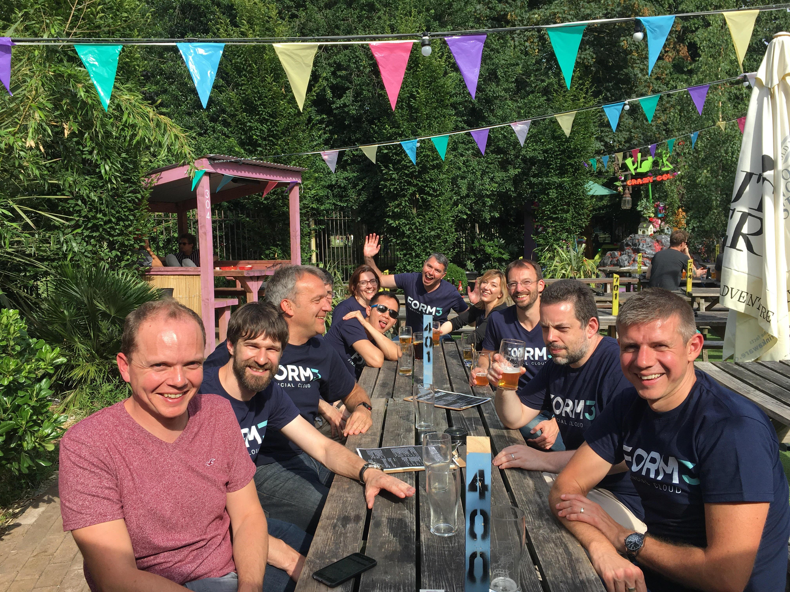
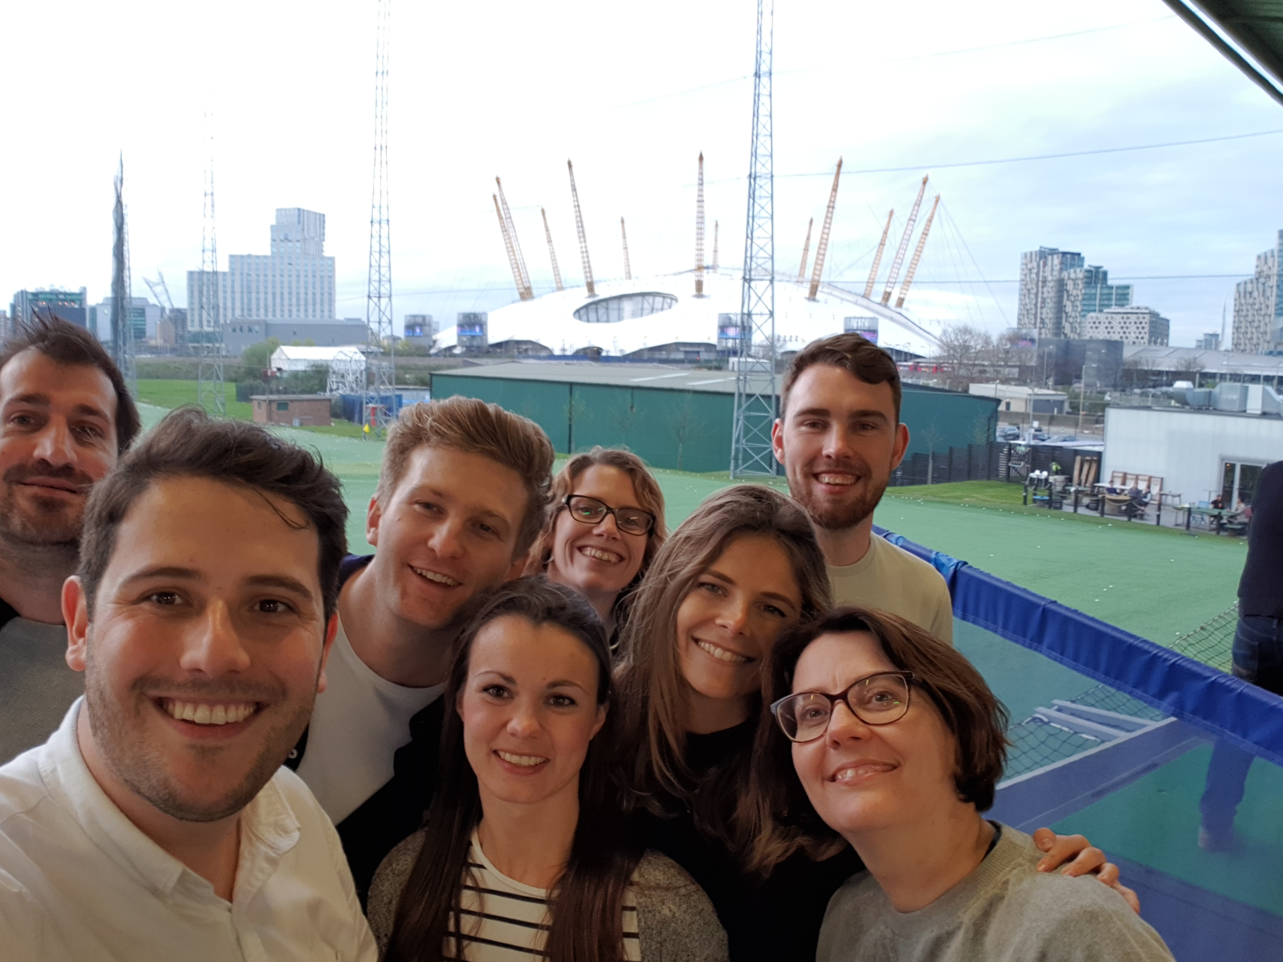
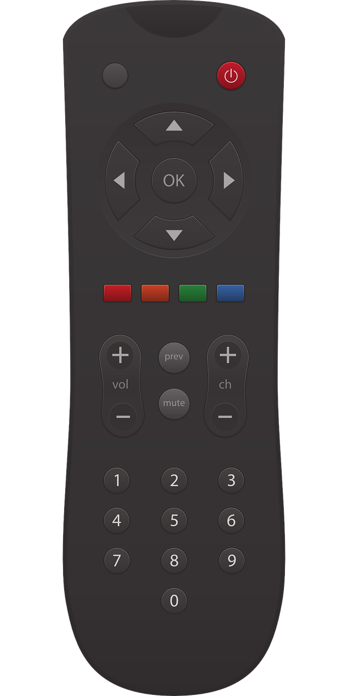

Thank you
https://github.com/ewilde/kubecon
this talk
https://form3.tech
service mesh yay!
and/or
working
We only hire nice people!

